Slide 1
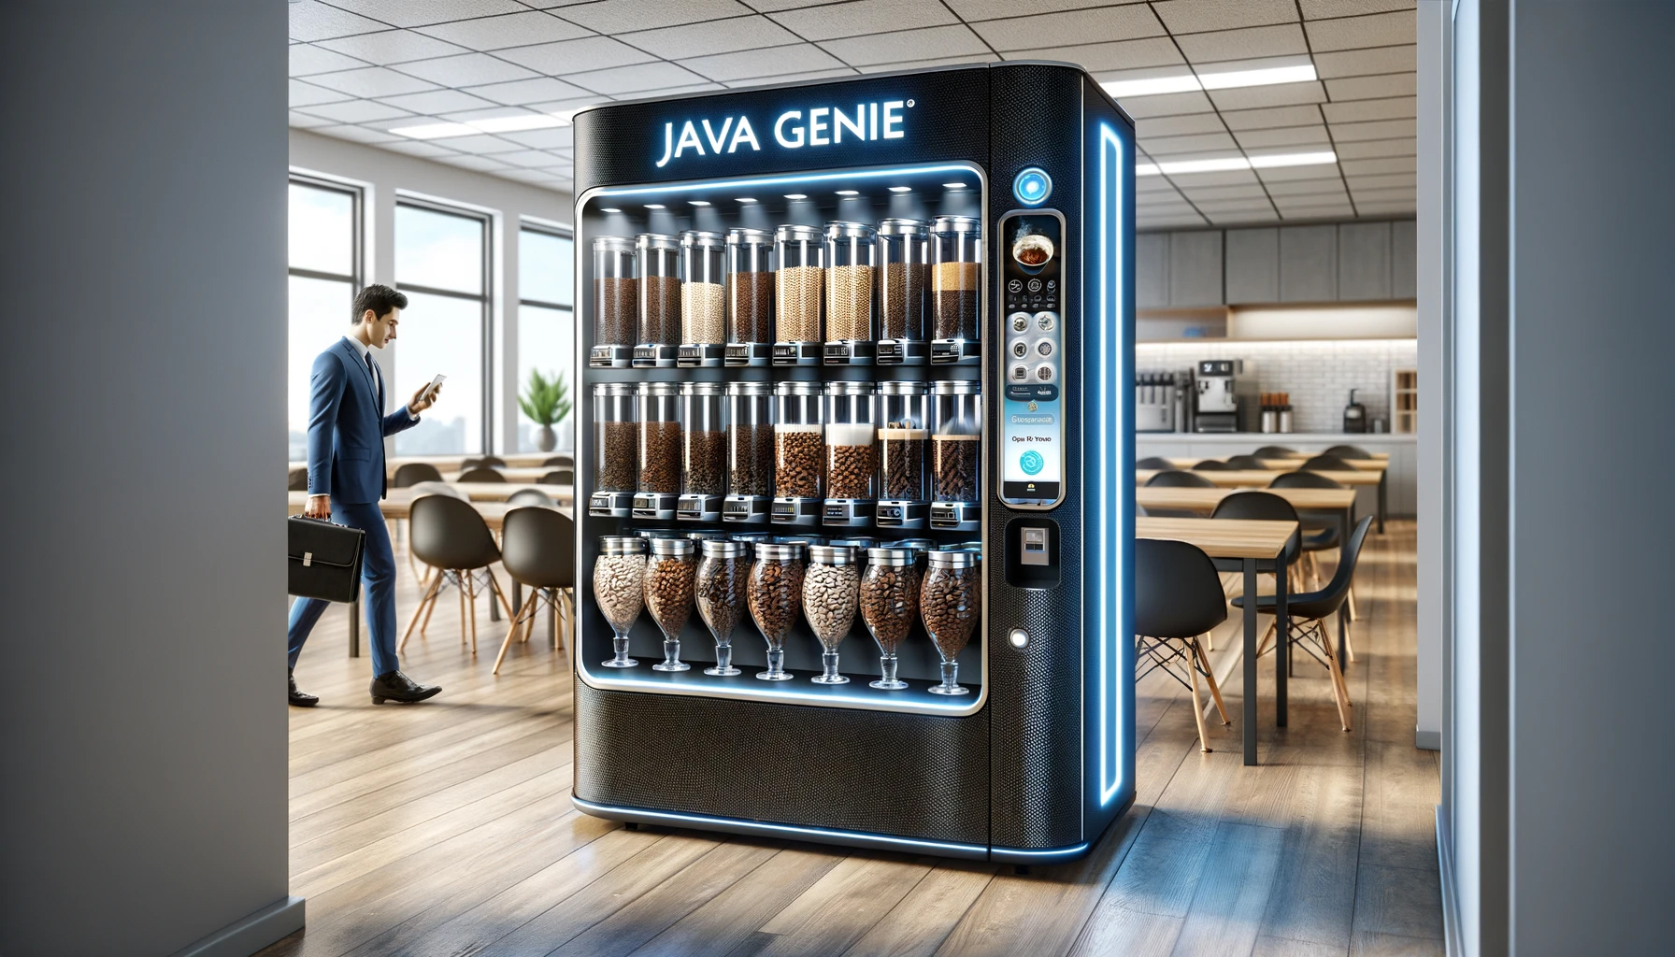
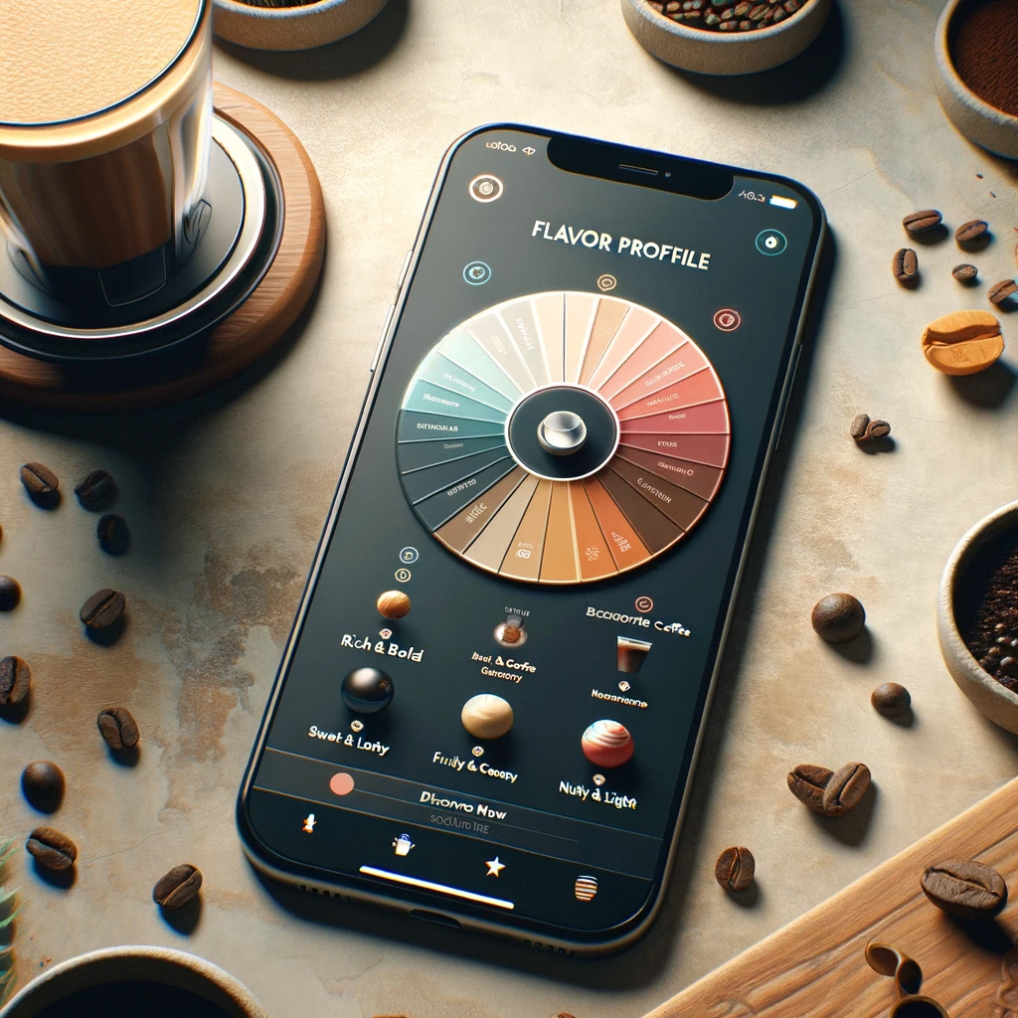

Java Genie
Apex Engineering
Business Opportunity
Overview
TM
TM

Slide 2
Executive Summary
Product
Java Genie Espresso Machine and Java Genie Vending Machine uses AI to learn users' coffee preferences and make barista-quality coffee directly in the office.
Value Proposition
Enhances employee productivity and satisfaction by saving time and money on coffee runs, offering personalized, high-quality coffee on-site.
Investment Opportunity
Capitalize on America’s $80 billion coffee industry with a product that meets daily consumption needs.
Addressing the daily coffee consumption of over 66% of Americans with a focus on convenience and quality.
Target Market
Corporate Offices, SME
Revenue Streams
Sales & Leasing: Machines sold directly or leased to corporate offices and businesses.
Transaction Fees: 3% fee Vending Machine drinks
Partnerships: Commissions from partnered coffee suppliers, cafes, and data brokers.
Maintenance: Opt-in program to fix machines
Timeline
2024: Java Genie App & AI Flavor Profiles
2025: Introduction of Coffee Rewards
2026: Espresso & Vending Machines
Apex Engineering introduces the Java Genie, ​AI-enhanced espresso machine designed to revolutionize workplace coffee culture.

Slide 3
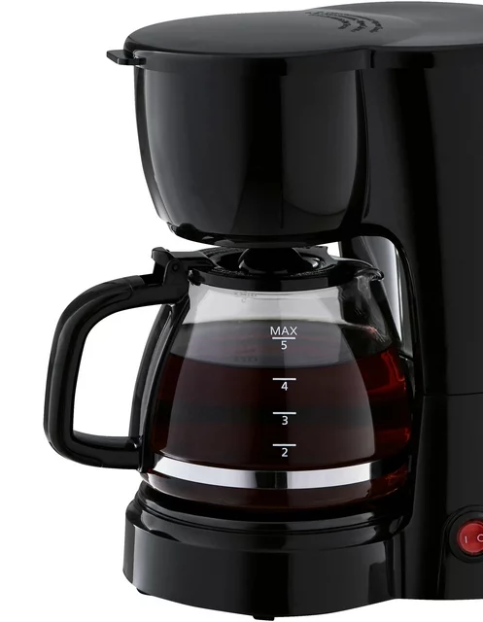
Problem Statement
Limited access to quality coffee
Corporate employees often experience a lack of access to high-quality, personalized coffee options in their workplaces leading to
Decreased satisfaction
Decreased productivity at work
One-Size-Fits-All Approach
Traditional office coffee solutions offer a one-size-fits-all approach that fails to cater to the diverse taste preferences of a modern workforce
Going to cafe leads to loss of workplace efficiency and increased downtime

Slide 4
Proposed Solution
Java Genie Espresso & Vending Machines
AI-Flavor Profiles Learns and adapts to individual flavor preferences to deliver the perfect cup of coffee.
User-Friendly Interface Easy ordering via smartphone app or built-in touchscreen display.
Barista-Quality Coffee Provides high-quality espresso and coffee drinks without leaving the office.
Java Genie App & Coffee Rewards
Shop: Re-supply and order coffee ingredients instantly
Coffee Rewards: Unified loyalty rewards and discounts from partner coffee suppliers
Benefits
Increased Productivity: The coffee machines in the office environment can greatly influence the employees' job performance[1] . Employees' productivity can be supported by smart coffee machines[2]. The coffee machines in the workplace have a positive impact on employees' commitment[3].
Cost-Effective: Saves on the time of coffee runs[4] and the expense of coffees at cafeterias[5].
Enhanced Satisfaction: The coffee machine talks are one of the effective methods to raise the workplace happiness and emotional ties[6].

Slide 5
Apex Engineering Overview
Vision and Goals
Revolutionize Office Coffee To be the leading provider of AI-enhanced coffee experiences in workplaces globally.
Quality and Innovation Commitment to blending cutting-edge technology with traditional coffee craftsmanship.
Sustainability and Growth Aiming for sustainable business practices while pursuing aggressive market expansion.
Ownership
Six co-founders with 38% ownership stake, pooling diverse expertise to drive innovation.
Investor Confidence
Backed by investors holding 62% of the company, reflecting strong market confidence and financial stability.
Infrastructure
Prototyping facility for R&D and production in Gainesville, FL
Partnered with top-tier component, food suppliers, and cloud service providers.

Slide 6

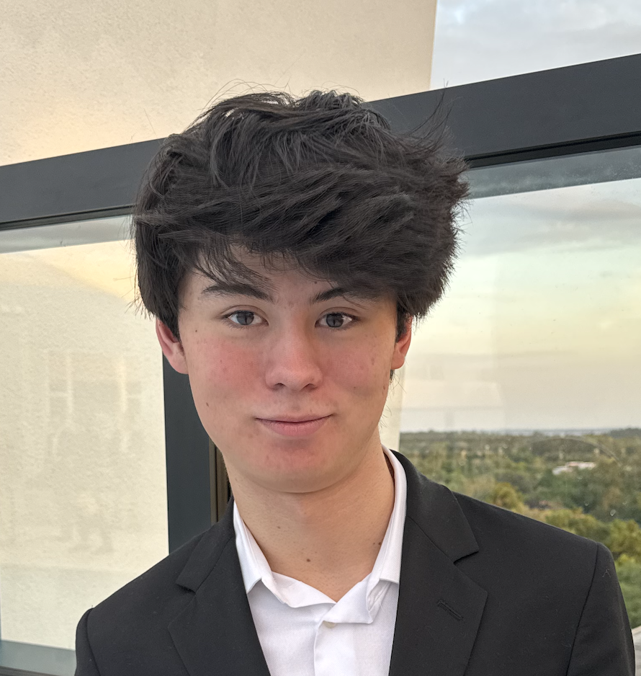
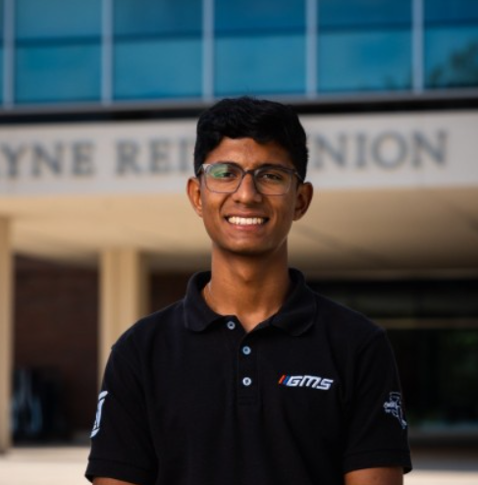
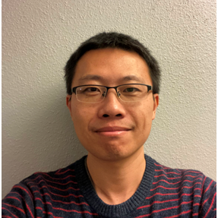
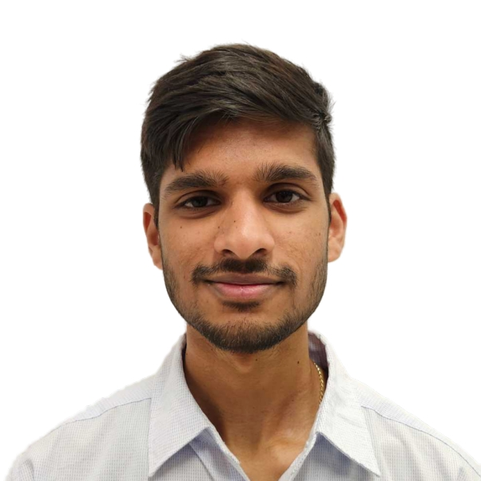
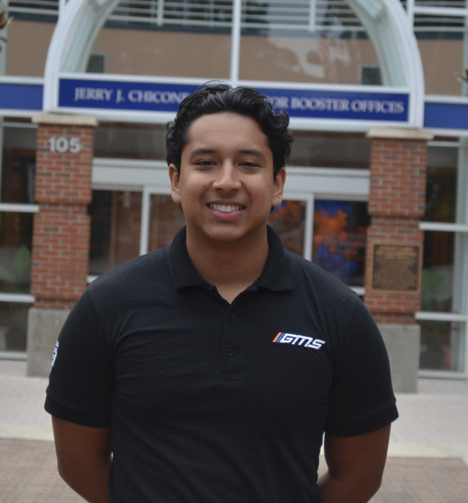
Management Team
Be part of the Coffee Revolution
with Apex Engineering. We are hiring the following roles:
AI Engineers
Firmware Engineers
Mechanical Designers
Culinary Experts
Supply Chain Operators
Sales Professionals
Marketing Professionals
Vijay Rathore
Design & Manufacturing
Jay Rosen
CEO
Landon McIntosh
CFO
Xiaoshan Wang
Software Engineer
Rithish Reddy Kaithi
Software Engineer
Alec Castro
Design & Manufacturing

Slide 7
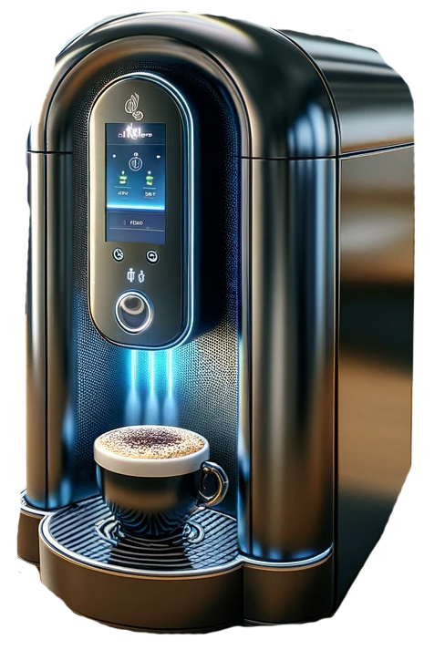
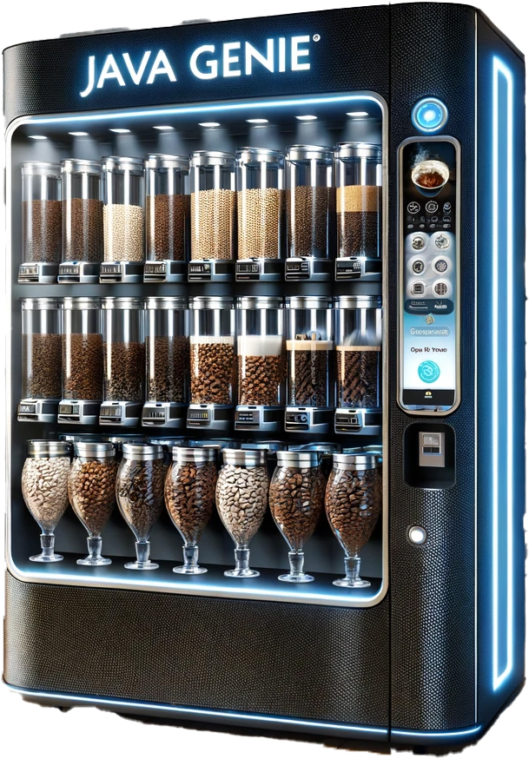
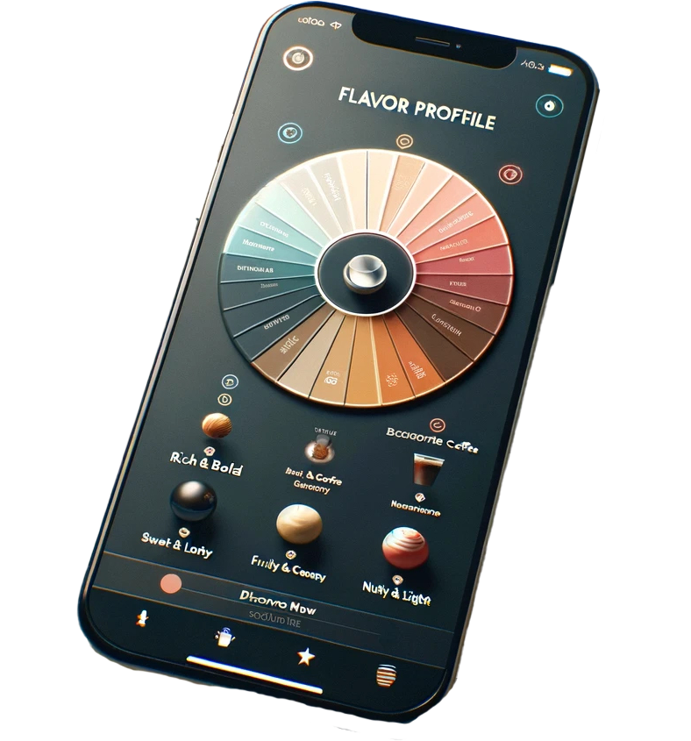

Java Genie Roadmap
Q3 2024
Q1 2025
Q1 2026
Q4 2026
Java Genie App
Coffee Rewards
& Partners Expansion
Java Genie
Vending Machine
Java Genie
Espresso Machine

Slide 8

Java Genie (2024)
AI Recommender for coffee drinks, cafes, and coffee products based on personalized flavor profiles
AI Flavor Profiles can provide new flavor combinations and surprises
Integrated AI Chatbot, an expert barista in your pocket

Slide 9
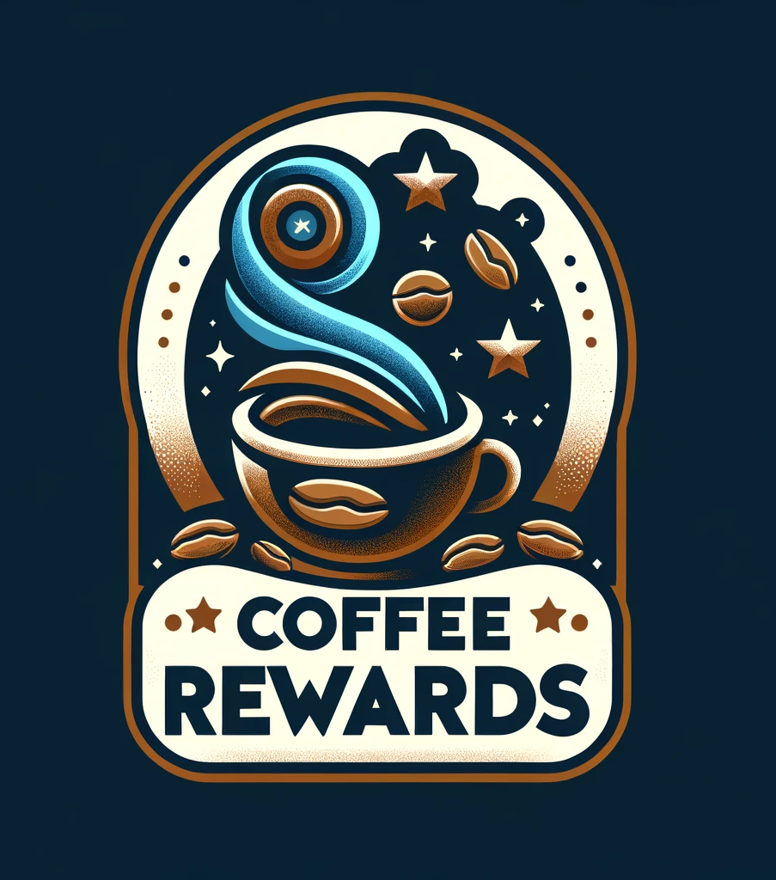
Coffee Rewards (2025)
Rewards and discount platform for using Java Genie app
Customers earn Coffee Rewards for filling out surveys, writing reviews, and making in-app purchases with partners for discount pricing.
Reviews and feedback help improve the AI algorithm

Slide 10
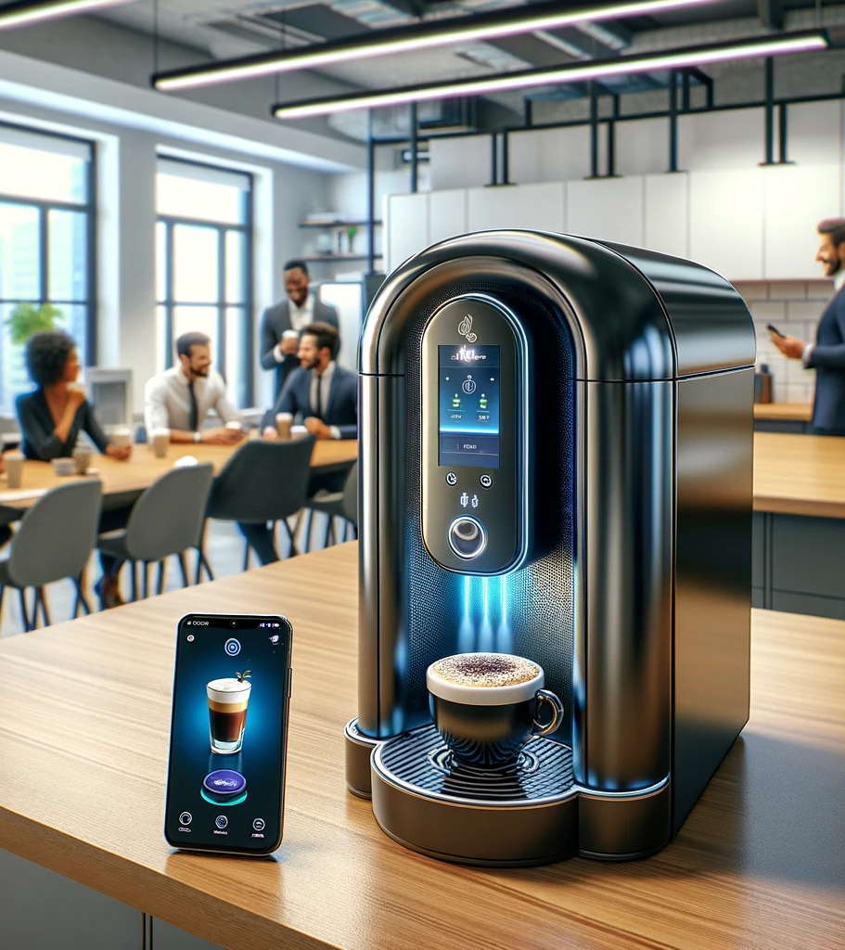
Java Genie Espresso Machine (Q1 2026)
All-in-one AI enhanced Espresso machine for home and small office.
Contains canister for 2 coffee beans and 5 flavors.
Retail Price: $2,000

Slide 11
Java Genie Vending Machine (Q4 2026)
All-in-one AI enhanced Espresso Vending Machine with larger capacity
6 coffee bean canisters
20 flavors
AI-automated
commercial industrial design
Retail Price ~$820 /mo lease

Slide 12

Maintenance Program
Maintenance program to fix and fine-tune Java Genie machines.
Espresso Machine program starting at $25 month.
Vending Machine program starting at $1,000 annual membership or $100 monthly fees.

Slide 13
Revenue Model
Java Genie Vending Machine
Consumer Machine
~$820 /mo
Recurring Revenue
$2,000
Machine Purchase
84%
Gross Margin based on 36-month lease
15%
Gross Margin
Revenue-driver
Introduces Business Clients to Brand
Additional Recurring Revenue
Opt-in Maintenance Program
Coffee Rewards Program

Slide 14
Revenue Stream Breakdown
$4 M
$2,000 Price
FY 2025 Launch
Consumer Machine
Vending Machine
Maintenance Program
$10.5 M
$830 Lease
FY 2026 Launch
$14.6 M
Net Sales
FY2026
Flagship Product
$100 K
Both Product Lines
FY 2025 Launch
Amounts shown based on FY2026 Pro-forma projections

Slide 15

Market Opportunity
US Coffee Industry is $80 Billion annually [7]
Current Spending: A survey by Zerocater reveals that San Francisco Bay Area companies are spending an average of $14,813 per month on office snacks and beverages. [8]
Willingness to Spend: 33% of companies surveyed are willing to spend more than their current budget on refreshments. [8]
Popular Choices: 94% of companies provide coffee and tea to keep their teams caffeinated, with 37% offering nitro cold brew coffee.
Potential Market Size:
Large Corporations: Hundreds of Fortune 500 companies in the US.
Mid-sized to Large Enterprises: Thousands across various industries.
Startups and High-Growth Companies: Numerous, with varying budgets.

Slide 16

Customer and Target Market
Primary Customer Profile
Businesses with disposable revenue and a focus on employee satisfaction.
Decision makers: HR managers, office administrators, and business owners.
Target Market Composition
Includes corporate offices, small enterprises, and businesses prioritizing employee well-being.

Slide 17
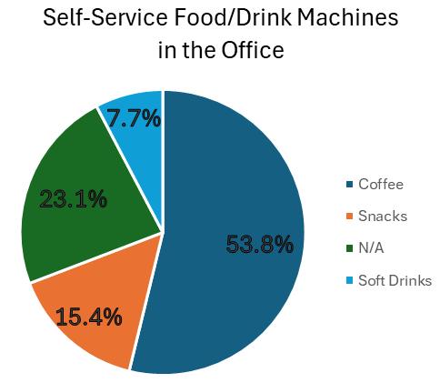
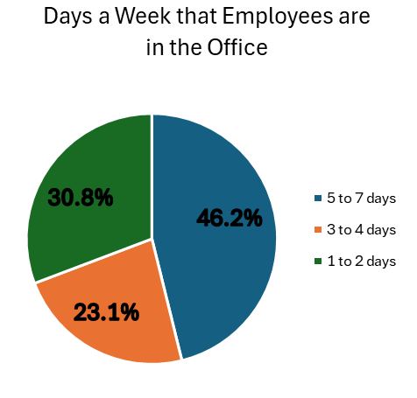
Customer Interview Summary
The questions we posed in the customer discovery interviews were aimed at gauging demand and validating the value proposition for our app-enabled on-demand coffee machine. In particular, understanding the customer's employee base, office hours, on-site staffing percentages, existing refreshments, and coffee budgets provided critical data to size the market opportunity and model potential revenue.
Key Findings:
Most interviewees expressed a strong interest in the concept of a self-service coffee machine that brews high-quality coffee.
The allocated budget for snacks and refreshments varies depending on the company size and preferences, ranging from $500 to $5000 per month.
The integration of technology, such as a mobile app for ordering and scheduling coffee, aligns with modern consumer preferences and enhances the overall user experience.

Slide 18
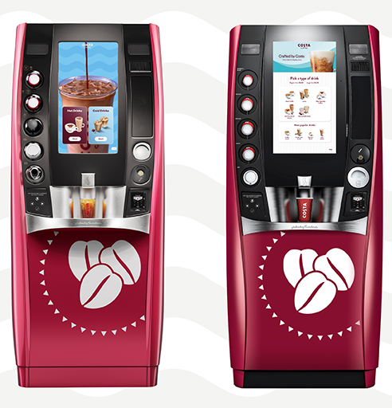
Competitive Analysis Vending Machines
Costa Coffee Smart Café
Offers an autonomous coffee solution with barista-quality drinks prepared touchless within a compact box. Costa is owned by Coca-Cola Co. [9]
200 drink combinations, served in 90 seconds
14,600 Smart Café’s in 14 markets
Costa sells $13 Million of coffee per day

Slide 19
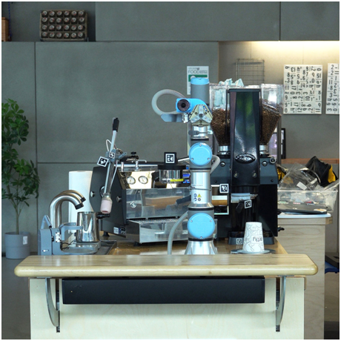
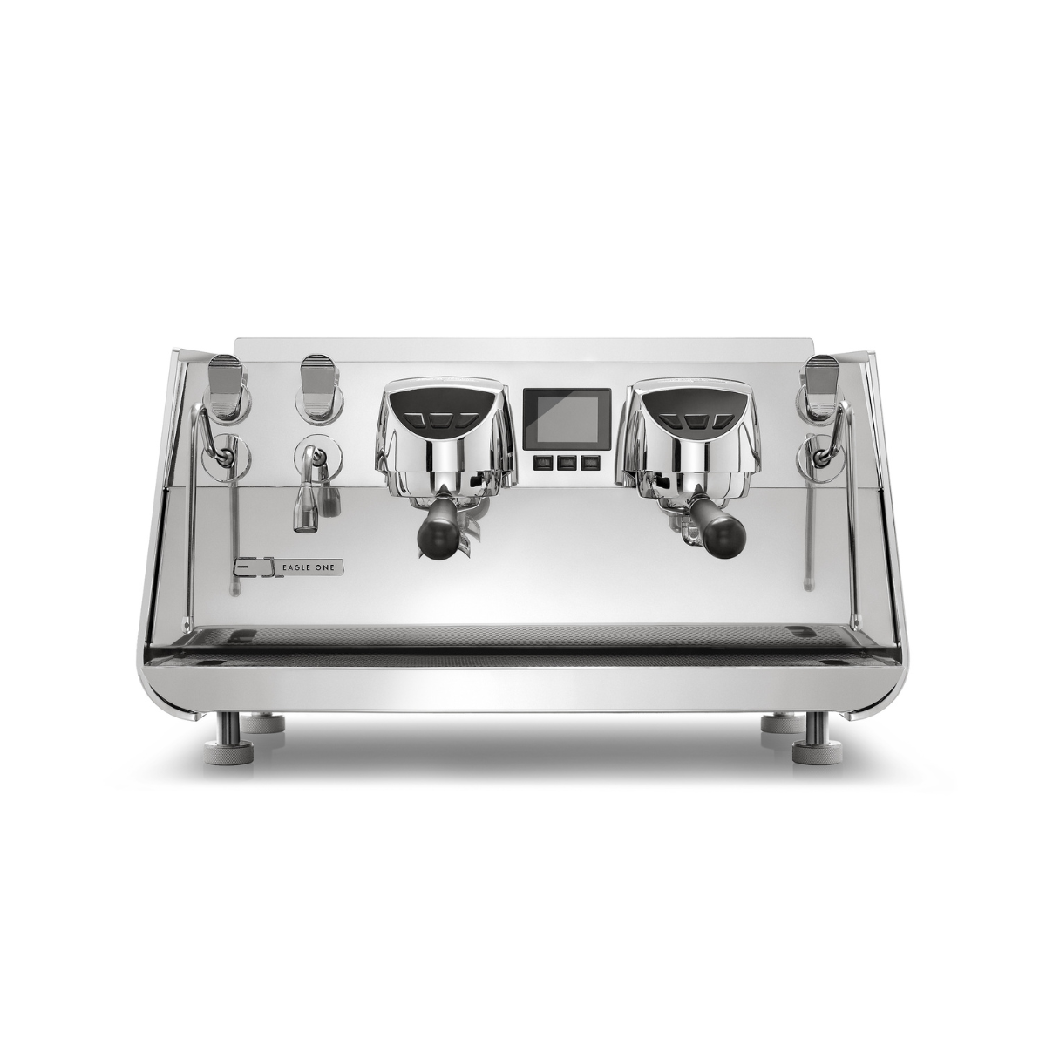
Competitive Analysis Espresso Machines
Artly Barista Bot
Artly uses artificial intelligence to control specialized robots and make coffees. Its focus to make coffees like a human, without sacrificing quality. It is mainly trained by some baristas, not constantly learned from the orders and comments from the customers. [10] Eagle One VIS
VIS is developed to digitally estimate the right dose in the cup using an algorithm calculation. [11]
It is not sufficient to intelligently adapt to the different flavors of customers.
The 2-group size costs $20500, and 3-group size costs $23500.

Slide 20
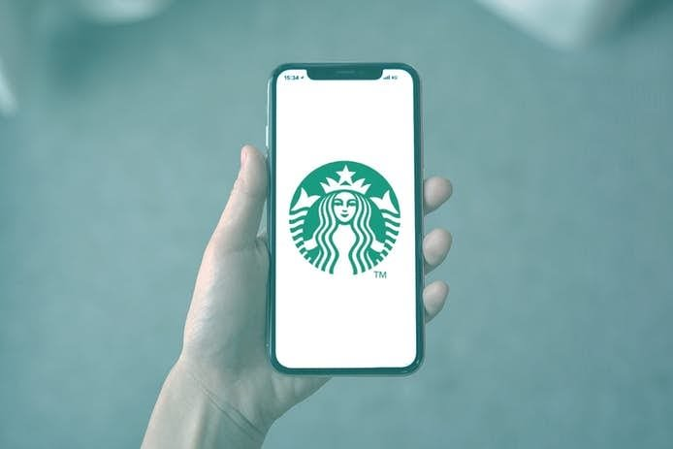

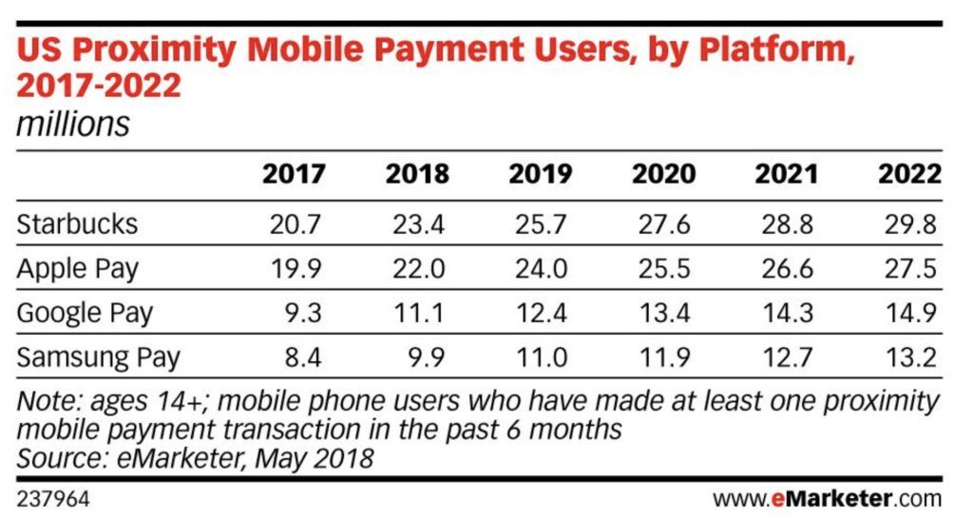
Competitive Analysis Coffee Apps
Deep Brew ​
Deep Brew is the AI program of Starbucks to personalize customer experiences, optimize store operations, and manage inventory.
It is specific to the coffee brand of Starbucks, not a platform for multiple coffee partners like ours. ​[12] ​
Barista GPT​
BaristaGPT enhances customer engagement with AI powered menus, custom-branded chat widgets, and seamless Point of Sale integration. [13]
50K+ chats started from customers, and $1 million in processed orders.
Focus is to facilitate customers to place order, rather than providing personalized flavors for customers.

Slide 21
Market Entry Strategy
Initial Rollout Target top-tier corporate offices with custom demo experiences.
Strategic Partnerships Collaborate with premium coffee brands and suppliers for cross-promotion.
Digital Campaign Utilize targeted ads and social media to create buzz around AI customization and piggyback off “Pumpkin Spice Season” marketing.
Coffee Rewards Introduce reward early to incentivize and retain initial user base.
Scaling Up Expand partnerships globally to North America, South America, and European Markets.

Slide 22
Distribution Channels
Manufacturer
Developer
Marketing Team
Storage Facility
App Store
Social Media Platform
Ground Transportation
Customer

Slide 23
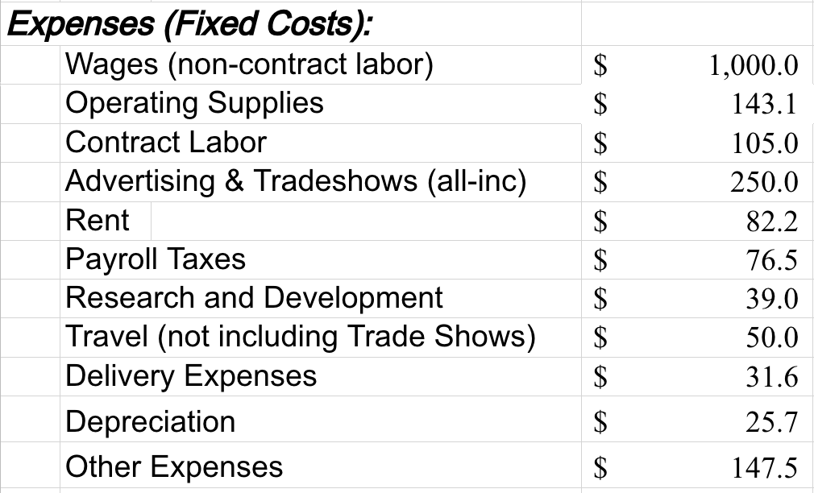
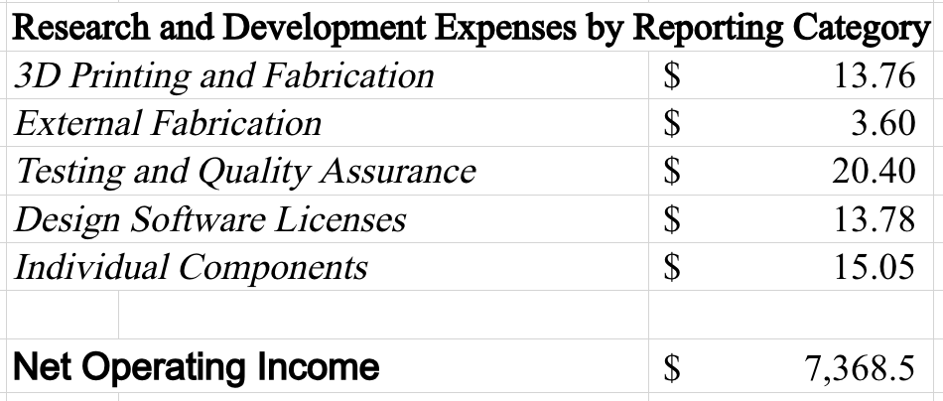
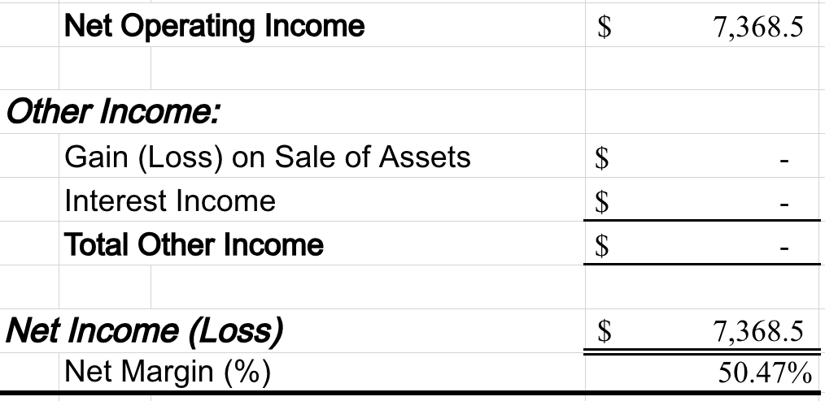
Expenses & Net Income
Amounts shown in thousands and based on FY2026 Pro-forma projections

Slide 24
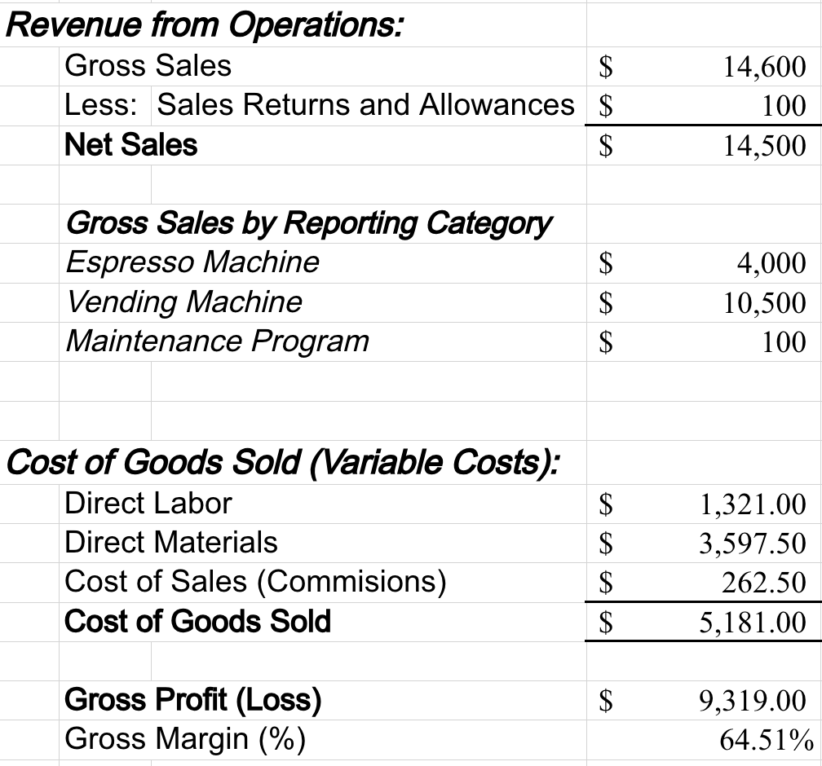
Revenue and Cost of Goods Sold
Amounts shown in thousands and based on FY2026 Pro-forma projections

Slide 25
Investment Opportunity Summary
Java Genie presents a unique opportunity to capitalize on the increase in employee benefit spending spurred by the return to office.
With minimal overhead and attractive margins, Java Genie has a unique path to profitability in FY2026 and beyond.
Current Valuation - $1.3 Million

Slide 26

Contact
Questions
contact@javagenie.app
Sales
sales@javagenie.app

Slide 27
References
[]
[1] L. Larsen, J. Adams, B. Deal, B. S. Kweon, and E. Tyler, "Plants in the workplace: The effects of plant density on productivity, attitudes, and perceptions", Environment and Behavior, vol. 30, no. 3, pp. 261-281, 1998.
[2] L. Brugmans, H. Appel-Meulenbroek, A Kemperman, and L. Dinnissen, "The strategic value of smart work environment applications," The Leader: Corporate Real Estate & Workplace, vol. 16, no. 3, pp. 28-29, 2017.
[3] E. Conway, and K. Monks, "Unravelling the complexities of high commitment: an employee-level analysis," Human Resource Management Journal, vol. 19, no. 2, pp. 140-158, 2019.
[4] https://officeology.com/blog/benefits-having-office-coffee-machine/
[5] https://www.corpcofe.com/ways-your-office-coffee-machine-can-save-you-money/
[6] M. Mousa, H. K. Massoud, and R. M. Ayoubi, "Gender, diversity management perceptions, workplace happiness and organisational citizenship behaviour," Employee Relations: The International Journal, vol. 42, no. 6, pp. 1249-1269, 2020.
[7] https://www.statista.com/topics/1248/coffee-market/#topicOverview ​
[8] https://us.costacoffee.com/our-coffees/on-the-go
[9] https://zerocater.com/resources/workplace-studies/survey-insight-workforce-snacking-habits/
[10] https://artly.coffee/ [11] https://victoriaarduino.com/eagleone/
[12] https://www.linkedin.com/pulse/starbucks-magic-artificial-intelligence-enhancing-coffee-pavithra-s/
[13] https://www.baristagpt.com/

